Slide 1
HackWIE
Team Name- IEEEverts
(Shalini Agrawal, Shatakshi Singh, Harshita Das)
Category- Agriculture

Slide 2
Problem Statement
To create a portal for farmers about latest government schemes in agriculture and that is easy to use & understand.

Slide 3
Objective
Our objective is to help those who provide us food, by making their job easy.
The government websites are complicated and confusing, so our aim is to ease the load for farmers by creating a common platform that is easy to use.
It is really difficult to search every scheme separately, so we want to create a common platform for all.

Slide 4
Features
Easy to use
Easy to understand
Updated schemes
Local language available
State level & Central level, all schemes at one place.
Free of cost

Slide 5
Technology Stack
Design thinking
Practical application
UI/UX design
Html
CSS

Slide 6
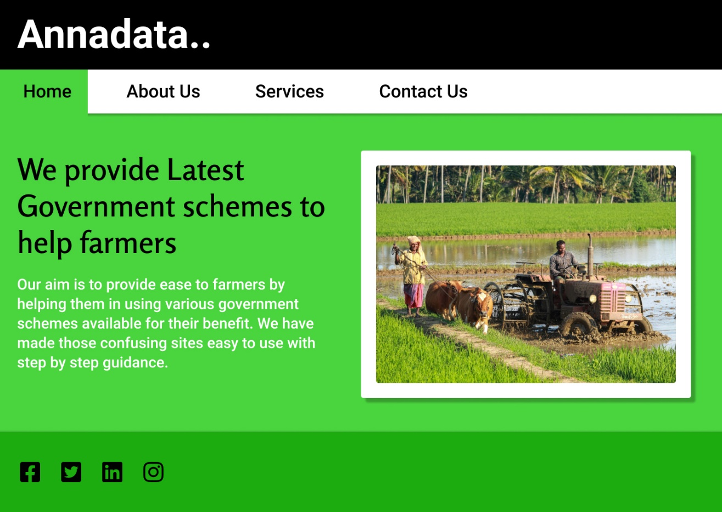
Basic prototype

Slide 7
THANK YOU

